Slide 1
SSAS Tabular model
Mentoring Platform from Aroha

Slide 2
Agenda
About Data Storage and Reporting
How Queries executes and impact on performance
SQL Server, SSIS, SSRS and Excel for BI
SQL Server, SSIS, SSRS, SSAS and Excel for BI
SQL Server, SSIS, SSRS, SSAS Tabular Model and PowerBI for BI

Slide 3
RDBMS → Reporting (Operations)
EXCCEL
SQL Server
ORACLE
SSRS
MYSQL
POWERBI
Select c.name, c.category, d.year, sum(sales_amt), sum(cost_amt)
From customer c, sales_fact, date d
Where customer.cust_id = sales_fact.cust_id
And date.date_id = sales_fact.date_id
Group by c.name, c.category,d.year

Slide 4
MSBI – ETL & DW and Analytical Reporting
STATIC REPORT / pre defined (SSRS)
Source System
RDBMS
(SQL SERVER)
ETL
SSIS
EDW
(Tables)
AD HOC REPORT
(build the report based on the need)
Data
Mart
(tables)
SQL
ODS
(tables)
External Reporting / downstream apps
Landing DB
Staging DB
DASHBOARDS
(POWERBI)

Slide 5
Way Query Executes based on Relational Data Store
TABLES
Select c.name, c.category, d.year, sum(sales_amt), sum(cost_amt)
From customer c, sales_fact, date d
Where customer.cust_id = sales_fact.cust_id
And date.date_id = sales_fact.date_id
Group by c.name, c.category,d.year
Access 3 Tables
Join three tables
Process the inner join
Filter
Group
Aggregation
Send the out put
It access all the columns in the table
While processing
Fact Tables – Only Transactions
Dimension – natural, sur id, all the other columns
Set of attributes, more than 25….
Dimension – Wider by nature (more columns)
Fact – Narrow by Nature (fewer columns)

Slide 6
View & Indexed View / Mat View
Access 3 Tables
Join three tables
Process the inner join
Filter
Group
Aggregation
Send the out put
VIEW
Select c.name, c.category, d.year, sum(sales_amt), sum(cost_amt)
From customer c, sales_fact, date d
Where customer.cust_id = sales_fact.cust_id
And date.date_id = sales_fact.date_id
Group by c.name, c.category,d.year
INDEXED_VIEW / MAT VIEW
Select c.name, c.category, d.year, sum(sales_amt), sum(cost_amt)
From customer c, sales_fact, date d
Where customer.cust_id = sales_fact.cust_id
And date.date_id = sales_fact.date_id
Group by c.name, c.category,d.year
CAPTURE RESULTS as an object in your DB
Select c.name, c.category, d.year, sales_amount, sales_cost
From cust_year_sales
Accessing one table
Performance is much better
Pre aggregated Data,
Pre calculated Data,
Pre processed Data

Slide 7
SSAS – MOLAP (multi dimensional processing) SS ANALYSIS SERVICES
EXCCEL
SQL Server
MOLAP Designer
ORACLE
SSRS
MOLAP CUBE
MOLAP CUBE
MYSQL
POWERBI
MOLAP CUBE
MOLAP CUBE
DATA IS IN TABLES
RDBMS
DATA IS IN CUBES
SSAS

Slide 8
RDBMS DATA → CUBE FORMAT
Product
P_Name
P_cat
P_Fam
50
p1, p2, p3 , p4
prod
365
Cust
Dim
Name
City
Type
Period
Date
Month
Quarter
Year
d1, d2, d3 , d4
date
Sales_fact
S_id
C_id
P_d
D_id
Qty
Cost
C1, c2, c3 , c4
customer
SSAS
1000
2,00,000

Slide 9
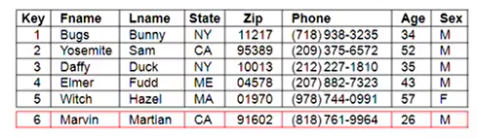
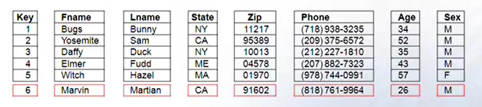
Table Vs Columnar Database
Row Oriented Data Store
Columnar Oriented Data Store
Assume you want to run following Query on the above tables
Select avg(age) from customer;
In the tabular format you are accessing all the rows and columns (full scan) to get the answer.
In the columnar database you access only the age column, your IO is less and thus performance is better

Slide 10
SSAS – Tabular Model
EXCCEL
SQL Server
SSAS Tabular Designer
ORACLE
SSRS
MYSQL
TABULAR MODEL
TABULAR MODEL
POWERBI
TABULAR MODEL
TABULAR MODEL

Slide 11
ROLAP, MOLAP & Tabular Model Store
RDBMS
REPORT
ROLAP
METADATA
RDBMS
METADATA
MOLAP
REPORT
RDBMS
METADATA
IN MEMORY
COLUMNAR
Tabular Model
REPORT

Slide 12
Data Storage -- Visualization
Table (RDBMS)
Cube
Columnar Store
Cust_Dim
Name
City
Type
Name
City
Type
CITIBANK
BLR
B2B
CANARA
BLR
B2B
SBI
BLR
B2B
Cust_name | Cust_city | Cust_type
CITIBANK | BANGALORE | B2B
CANARA | BANGALORE | B2B
SBI | BANGALORE | B2B
Pre Processed
Pre Aggregated
Physical Storage
Columnar
IN MEMORY Database
Compression
SQL
MDX
DAX

Slide 13
Application & Purpose of the application
LEARNER
Understand Data
Data from RDBMS
Data from Files
Data from other sources
UNDERSTAND
BUSINESS
Focus on specific industry of your project
Visualize data in dimensional model
Identify Dimensions
Identify Hierarchies
Identify Facts / Measures
User1
SSAS TABULAR MODEL
Use SSAS Tabular Model
Build Star / Analytical Schema
Add more measures
Hide columns from end users
Deployment of Tabular Model to cloud (azure, powerbi)
User2
User3

Slide 14
RDBMS Vs MOLAP Vs Tabular Model
RDBMS (Tables and Rows) – Tabular Structure (Rows & Columns)
MOLAP – Cube Structure – Dimensions & Measures
Tabular model – Columnar Data Store (In Memory & Compressed)
RDBMS – We use tables as the structure to store data. SQL as the Query language.
MOLAP – Cube – We use cubes as structure, consists of Dimensions and Measures as components to build the cube. MDX is the language which we use to Query the data.
Tabular Model – Columnar objects as the structure, use DAX functions to Query the Data. Used for analytical queries. Its also an in memory data storage. When gets loaded into memory, the data gets compressed effectively.

Slide 15
Tabular Model
By using state-of-the-art compression algorithms and multi-threaded query processor
The Analysis Services Vertipaq analytics engine delivers fast access to tabular model objects and data by reporting client applications like Power BI and Excel.
Tabular Model becomes the one version of Analytical Databases for PowerBI users.
Tabular Model can be deployed in the Azure cloud so that multiple regional PowerBI users can access the data required.
Enterprise / Departmental Tabular Models can be created for Power users who use PowerBI and Excel
This server can run in-memory or in DirectQuery mode

Slide 16
SSAS Tabular Model Deployment
Deployed to Power BI Premium account
Deployed in Azure Analysis Services
SQL Server Analysis Services configured for Tabular server mode.
Deployed tabular models can be managed in SQL Server Management Studio or by using many different tools.
This model gets accessed by PowerBI, Excel, SSRS as part of Microsoft Business Intelligence suite.

Slide 17
Features of Tabular Model
Tabular models are relational Modeling constructs (Models, Tables, columns), articulated in Tabular Model Scripting Language, Tabular Object Model Code.
We can force the end users to all the derived columns at the tabular model level.
End users can create their dashboard specific measures outside the model and they won’t be stored in the model.
We can use most of the DAX functions to calculate measures, KPIs, etc.
These measures are calculated at the model level and can be used be used in the reports.
When we use the model, since the values are already calculated and stored, there by we can improve the performance of the reports / dashboards.

Slide 18
Advantages of Tabular Model
We can maintain single version of model across the organization.
We can avoid creating models with different versions across BI platforms. That’s how we can control.
We can implement incremental loads in the model.
We can use TOM or TMSL scripts to automate the refresh the data in the model.
We can use this models and query them using DAX queries to embed the reports in web pages. Following is the DAX query to get the KPI from the model:

Slide 19
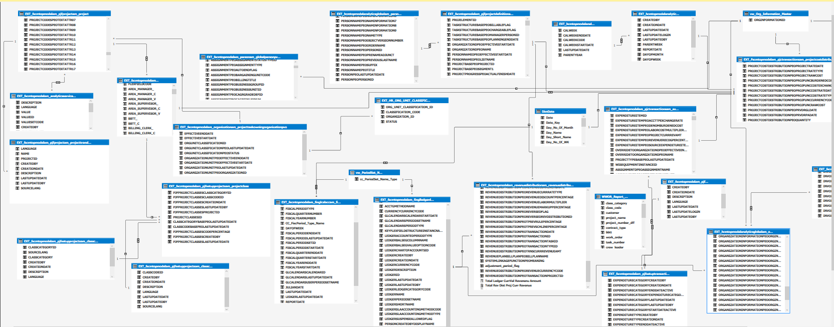
Tabular Model - Sample

Slide 20
Sample DAX Query for a Card
Total Crew members:
Evaluate( SUMMARIZE( CALCULATETABLE( TBL_T_TSCrew, TBL_T_TSDetails, TBL_T_TSHeader, TBL_M_EMPLOYEE_HIERARCHY, FILTER(TBL_M_EMPLOYEE_HIERARCHY,TBL_M_EMPLOYEE_HIERARCHY[AREA_SUPERVISOR_NUMBER] in ALLSELECTED(TBL_M_EMPLOYEE_HIERARCHY[AREA_SUPERVISOR_NUMBER])),
FILTER(TBL_T_TSHeader,TBL_T_TSHeader[WeekEndingDate] in ALLSELECTED(TBL_T_TSHeader[WeekEndingDate])),
FILTER(TBL_T_TSCrew_RP,TBL_T_TSCrew_RP[EmployeeName] in ALLSELECTED(TBL_T_TSCrew_RP[EmployeeName])),
FILTER(TBL_T_TSCrew,TBL_T_TSCrew[EmployeeName] in ALLSELECTED(TBL_T_TSCrew[EmployeeName])) ), "Total Crew Members", (TBL_T_TSDetails[Total Crew Members New]) ) )

Slide 21
What we can do using tabular model designer
creating semantic model objects
Tables
Partitions
Relationships (single and bi-directional)
Hierarchies
Measures
KPIs
Perspectives

Slide 22
Compatibility Level
Find the release of your SSAS Tabluar Model
Different releases supports different deployment options. Latest compatibility level supports for PowerBI Premium account
The latest supported compatibility level is 1500
Major features in the 1500 compatibility level include:
Calculation groups
Many-to-many relationships
Supported in Power BI Premium
Check compatibility level for a tabular database in SSMS
In SSMS, right-click the database name > Properties > Compatibility Level.

Slide 23
Thank you
Aroha Team

